Slide 1
Fundamental Computer Programming- C++ Lab(I)
Lab 4
Runs in a String
Week 4, Fall 2022
Rung-Bin Lin
International Bachelor Program in Informatics
College of Informatics
Yuan Ze University

Slide 2
Purposes
Learn about characters and strings
Learn how to use for loop
Develop problem solving skills

Slide 3
String Type
#include <string>
A string is stored as an array of characters.
An array is a continuous memory region that will store objects of the same type. The object’s type can be char, int, string, double, etc. It has a sequence of locations. A location will hold exactly one object.
A string constant is double quoted by “”, for example “astring”.
A string is an array of characters.
char s1[] = “happy”;
string s1(“happy”);
Length = 5 (not including end-of-string \0)
char s2[] = “ birthday”;
string s2(“ birthday”);
Length = 9
index
0 | 1 | 2 | 3 | 4 | 5
h | a | p | p | y | \0
index
0 | 1 | 2 | 3 | 4 | 5 | 6 | 7 | 8 | 9
 | b | i | r | t | h | d | a | y | \0
s1
S2:

Slide 4
More on string and characters
Each string is a character array. For example, if aStr is a string variable that stores a string “He loves you.”, aStr[0] will contain ‘H’, aStr[1] contains ‘e’, aStr[2] contains ‘ ‘, aStr[3] contains ‘l’, aStr[4] contains ‘o’, etc.
We can use a function aStr.length() to get the length of the string stored in aStr. It will return 13 for this example.
Each character is stored in computers using ASCII code. It is an integer. So we can have the following code.
int aDigit, anInt;
char aLetter;
aDigit = ‘9’ – ‘0’; // aDigit will have a value of 9.
anInt = ‘z’ – ‘a’; // anInt will have a value of 25.
aLetter = ‘a’ + 5; // aLetter will be the letter f.
You may need use static_cast<char>(90) to convert an integer to a character. You will get character ‘A’ in this example.

Slide 5
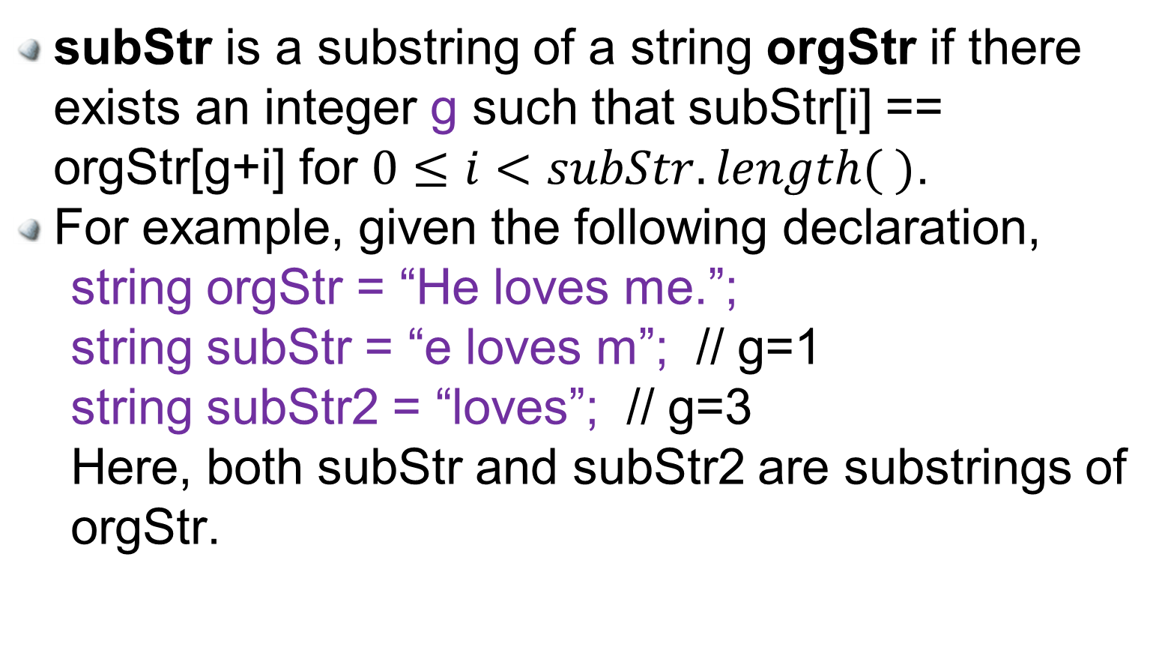
Substring of a string
subStr is a substring of a string orgStr if there exists an integer g such that subStr[i] == orgStr[g+i] for $0≤i<subStr.length( )$.
For example, given the following declaration,
string orgStr = “He loves me.”;
string subStr = “e loves m”; // g=1
string subStr2 = “loves”; // g=3
Here, both subStr and subStr2 are substrings of orgStr.

Slide 6
Manipulating a string
// Reversing a string
#include <iostream>
#include <string>
using namespace std;
Int main(){
string aStr=“abcdefg”;
char c;
int strLen = aStr.length();
for(int i=0; i<strLen/2; i++){
c=aStr[i];
aStr[i] = aStr[strLen-1-i];
aStr[strLen-1-i] = c;
}
cout << aStr << endl;
return 0;
}
Calculate string length
aStr.length();
Get access to a string element (i.e., a characters) at position i
aStr[ i ]
A string of length n is stored starting from position 0 through position n-1 in a character array.
Reversing a string of length n can be done by exchanging the character at position n-1 with the one at position 0, the one at position n-2 with the one at position 1, etc. The code is shown on the left.
n=5
Index:
0 | 1 | 2 | 3 | 4 | 5
aStr:
h | a | p | p | y | \0

Slide 7
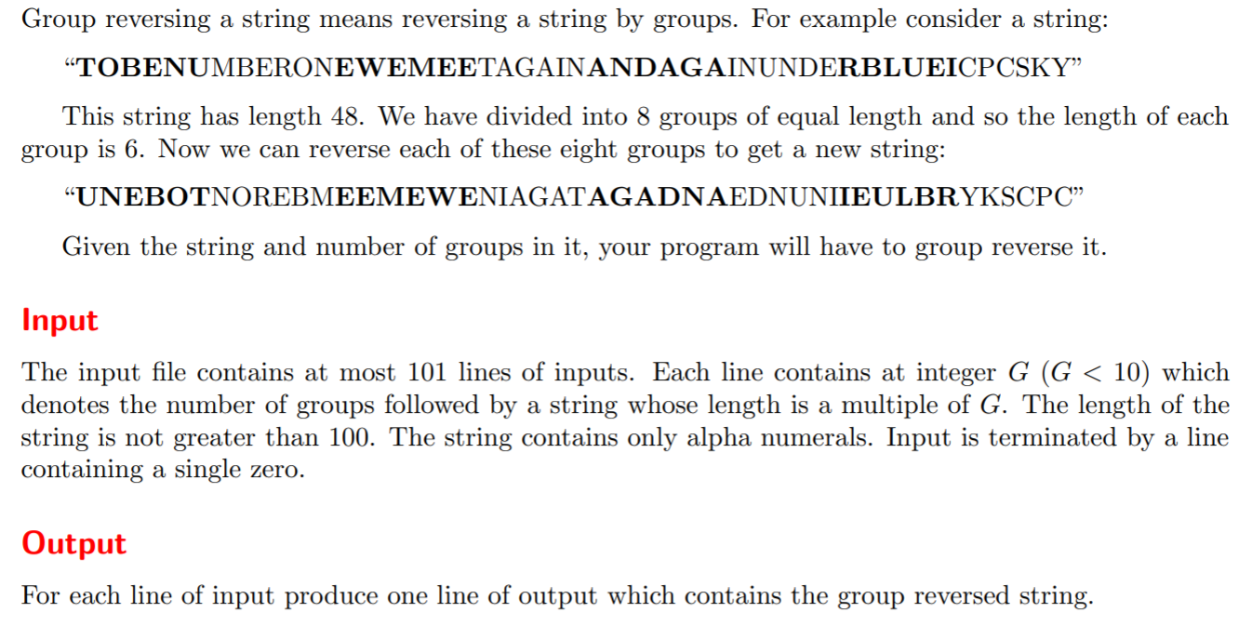
Group Reverse
an

Slide 8
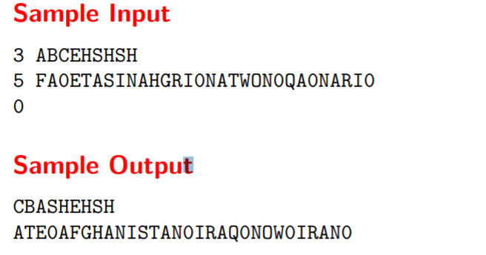
Example

Slide 9
Group Reverse
Group 0
Group 1
Group k-2
Group k-1
4k-1
0
1
2
3
4
5
9
4k-5
5k-5
5k-1
. . .
Group 0
Group 1
Group k-2
Group k-1
(k-1)p-1
0
1
p-1
p
2p-1
(k-2)p
(k-1)p
kp-1
 |  | …
 |  | …
. . .
 |  | …
 |  | …

Slide 10
Algorithm for Group Reverse
Input the number of groups
Read a string
Calculate string length
Calculate the length of each group
For each of all the groups
Reverse string
Print out the reversed string
Repeat (1) through (6) until end of input

Slide 11
Lab 4: Runs in a String
A run is a string’s substring that contains only one type of symbol. A run is not contained in any other runs. The length of a run is the number of symbols in the run. Given a string without containing any whitespaces, find
the number of runs,
the length of the longest runs,
the number of longest runs, and
As an example for the above three items, given a string “2AaaabB3333o#”, “2” is a run of length 1; “Aaaa” is a run of length 4. The above string has 6 runs, the length of its longest run is 4, the number of longest runs is 2. Here, the lowercase and uppercase of an alphabet letter are treated as the same type of symbol.
The length of the longest alphabet letter run.
For this, all alphabet letters are treated as the same type of symbol. For the above example, the length of the longest alphabet letter run is 6.
Requirements:
Your program should use cin to read a whole string into the program before it starts to find the runs in the string.

Slide 12
Two Keys
Dealing with uppercase and lowercase of a letter
Determining a run
Remember which symbol is being checked in the string.
Remember which type of symbol is being checked for forming a run.
Calculate run length,
Update longest run length and count the number of runs with the longest run length.

Slide 13
Input & Output Formats
Input format
The first line gives the number of test cases. Each test case takes a line which contains a string.
Output Format
The output of a test case takes three lines as shown in the example on the right. The first line gives the number of runs, the second line gives the length of longest runs, and the third line gives the number of longest runs .

Slide 14
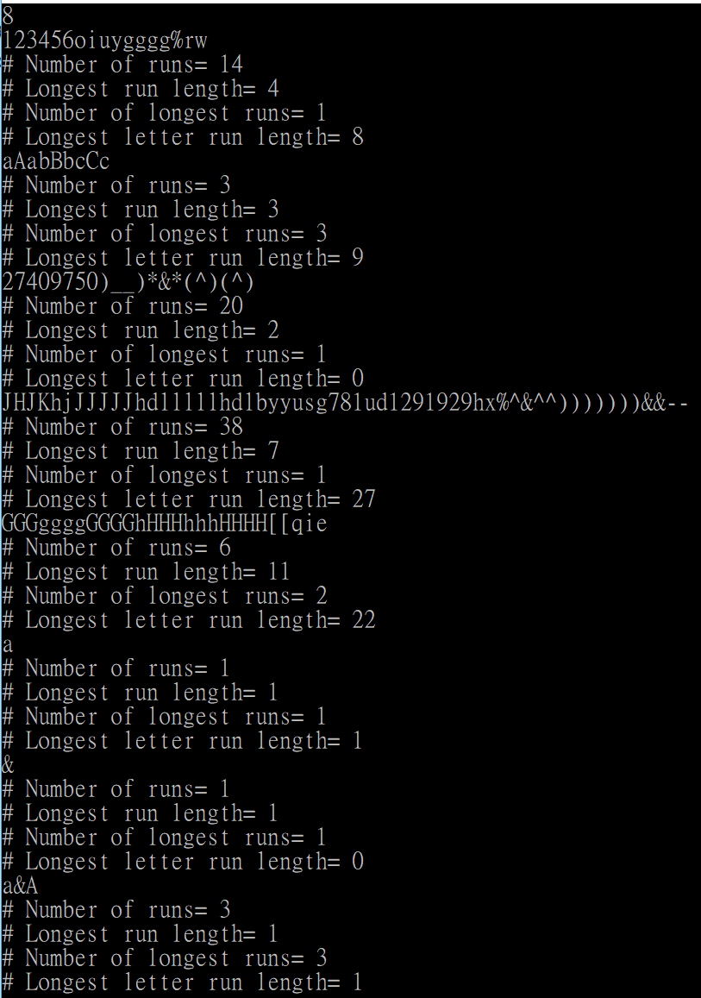
Output Example

